Slide 1
Gen AI Workshop IA as a Service

Slide 2


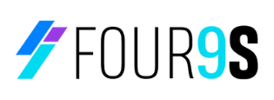
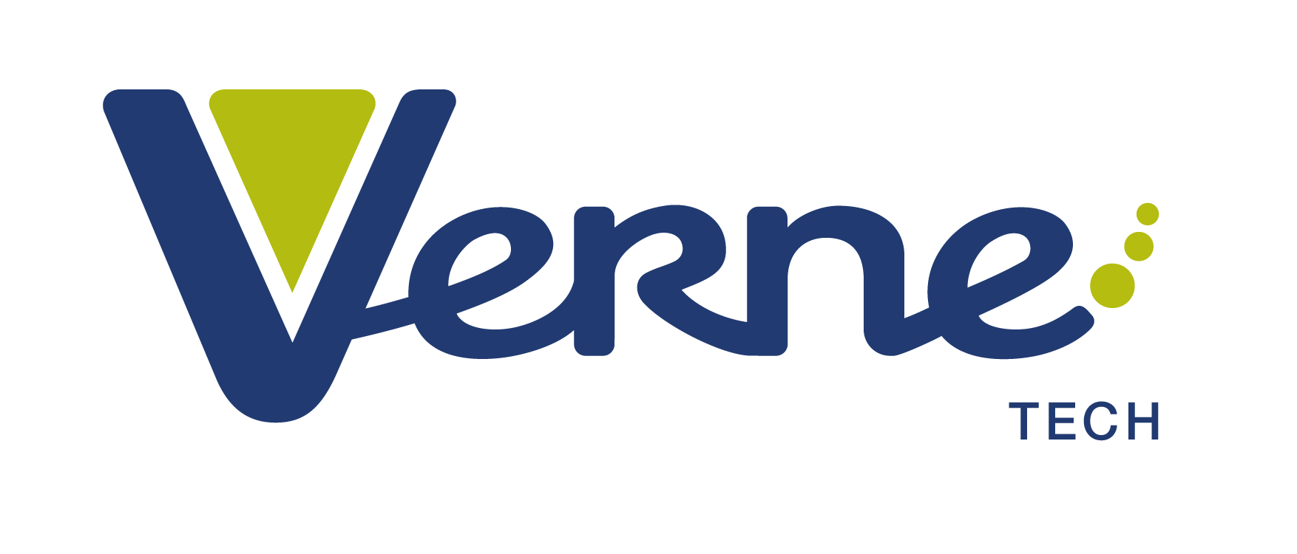

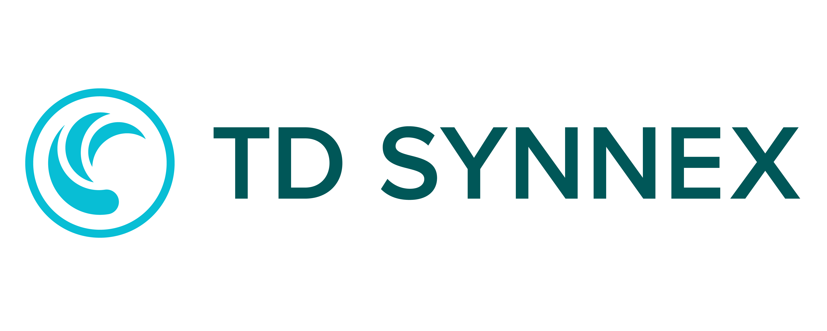
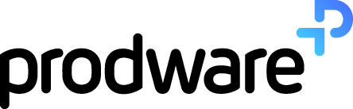
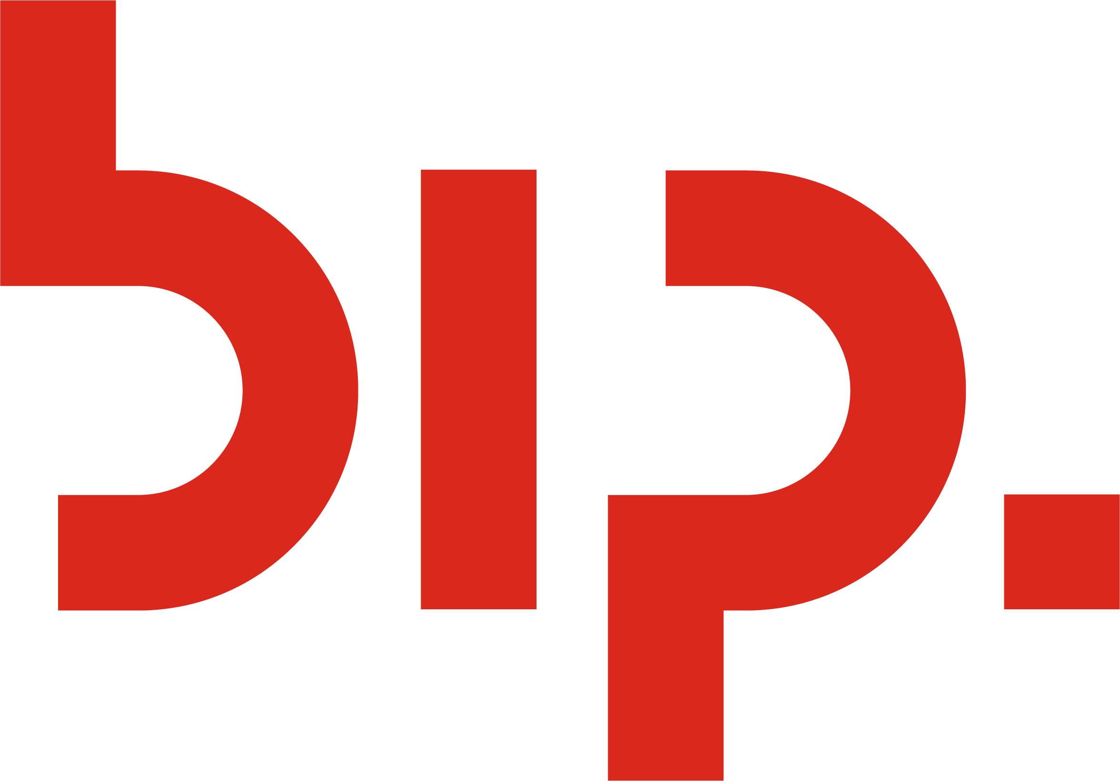
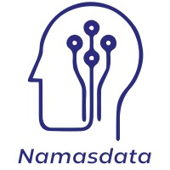
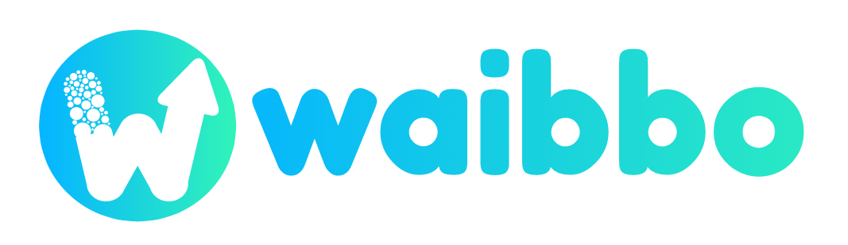
¡Gracias sponsors!
Platinum
Gold
Silver

Slide 3
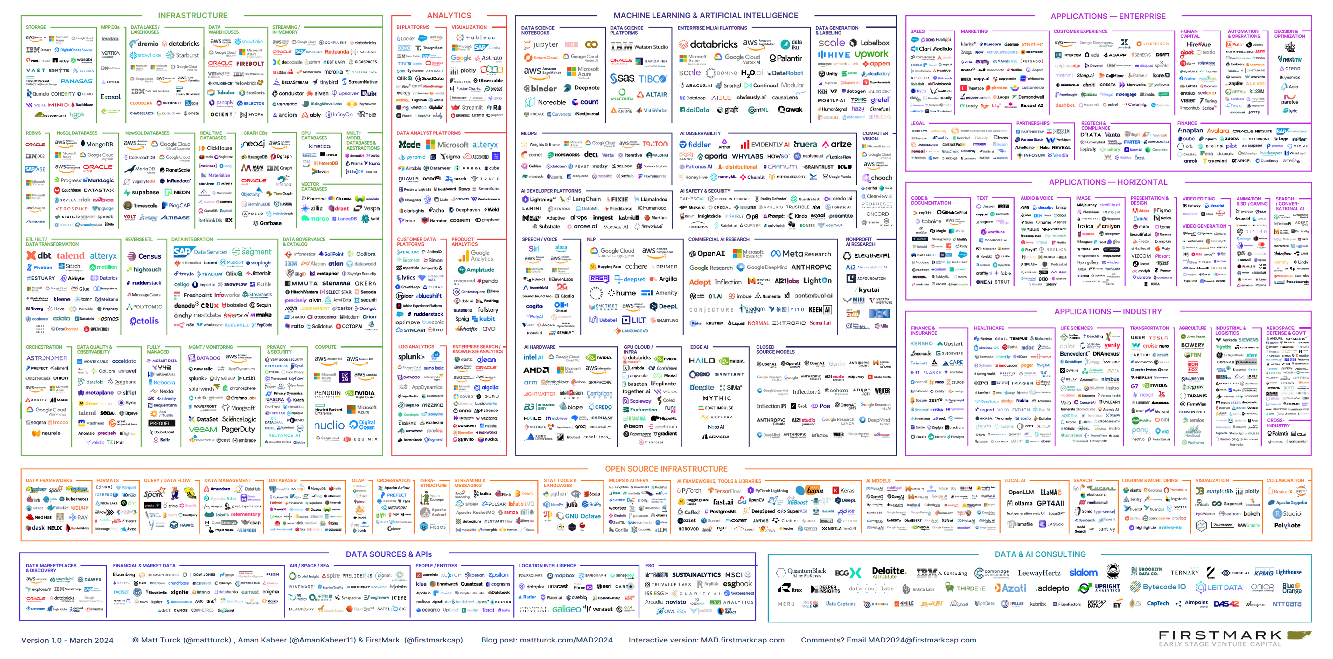
2024 Data and AI landscape

Slide 4
The next AI platform shift is here.
We need to evolve.

Slide 5
Organizations are experimenting with multiple models
# models providers pushed to use cases
(Experimental and in production)
Ref: 16 Changes to the Way Enterprises Are Building and Buying Generative AI | Andreessen Horowitz

Slide 6
Agents are becoming more capable

Slide 7
80%
of early AI projects fail to meet expectations due to complexity

Slide 8
The unified app platform for the era of AI
To
From
Multi-model
Single model
Automated workflows
Platform Shift
Simple POCs
Continuous improvement
Point-in-time ROI

Slide 9
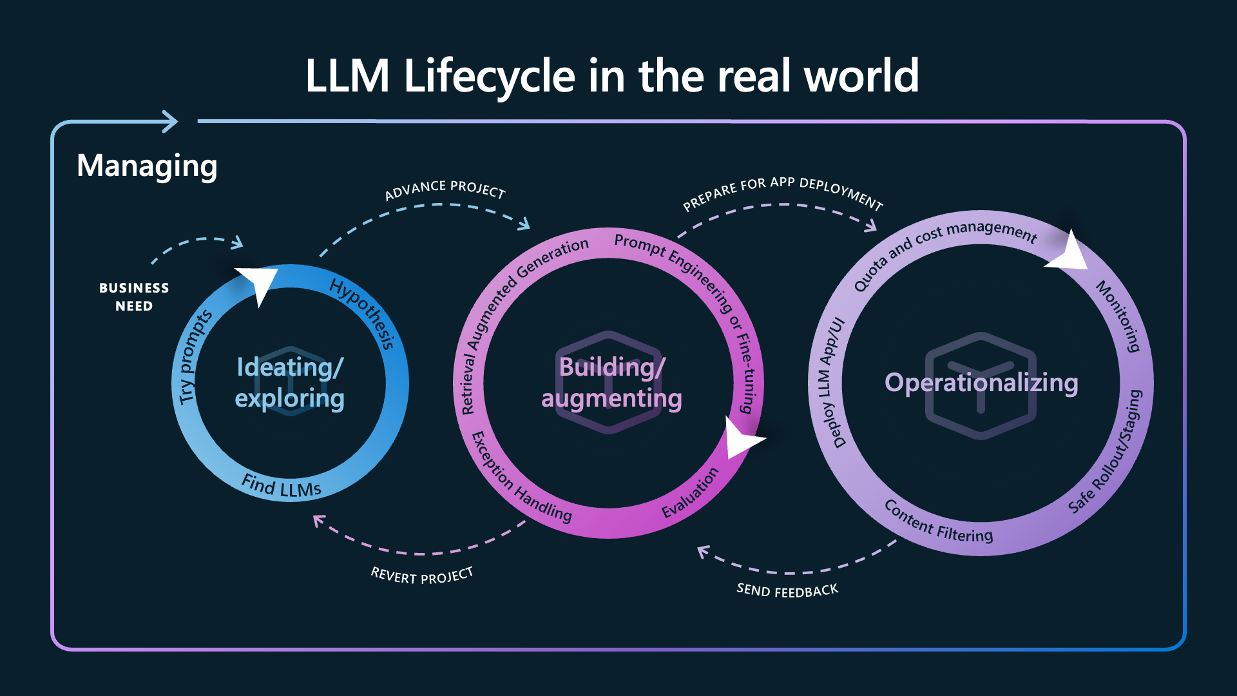
Notes:
https://gloveboxes.github.io/prompt_flow_workshop/
https://azure.microsoft.com/en-us/blog/building-for-the-future-the-enterprise-generative-ai-application-lifecycle-with-azure-ai/
Ideating and exploring loop
The first loop typically involves a single developer searching for a model catalog for large language models (LLMs) that align with their specific business requirements. Working with a subset of data and prompts, the developer will try to understand the capabilities and limitations of each model with prototyping and evaluation. Developers usually explore altering prompts to the models, different chunking sizes and vectoring indexing methods, and basic interactions while trying to validate or refute business hypotheses. For instance, in a customer support scenario, they might input sample customer queries to see if the model generates appropriate and helpful responses. They can validate this first by typing in examples, but quickly move to bulk testing with files and automated metrics.
Building and augmenting loop
Once a developer discovers and evaluates the core capabilities of their preferred LLM, they advance to the next loop which focuses on guiding and enhancing the LLM to better meet their specific needs. Traditionally, a base model is trained with point-in-time data. However, often the scenario requires either enterprise-local data, real-time data, or more fundamental alterations.
During this loop, the developer may find cases where the output accuracy doesn’t meet desired thresholds. Another method to alter the outcome of an LLM is fine-tuning. Fine-tuning helps most when the nature of the system needs to be altered. Generally, the LLM will answer any prompt in a similar tone and format. But for example, if the use case requires code output, JSON, or any such modification, there may be a consistent change or restriction in the output, where fine-tuning can be employed to better align the system’s responses with the specific requirements of the task at hand. By adjusting the parameters of the LLM during fine-tuning, the developer can significantly improve the output accuracy and relevance, making the system more useful and efficient for the intended use case.
Operationalizing loop
The third loop captures the transition of LLMs from development to production. This loop primarily involves deployment, monitoring, incorporating content safety systems, and integrating with CI/CD (continuous integration and continuous deployment) processes.

Slide 10
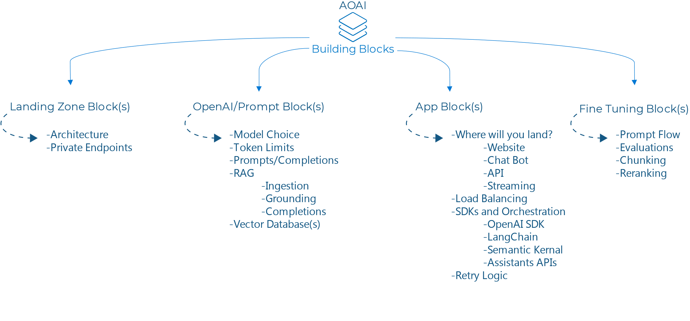

Slide 11
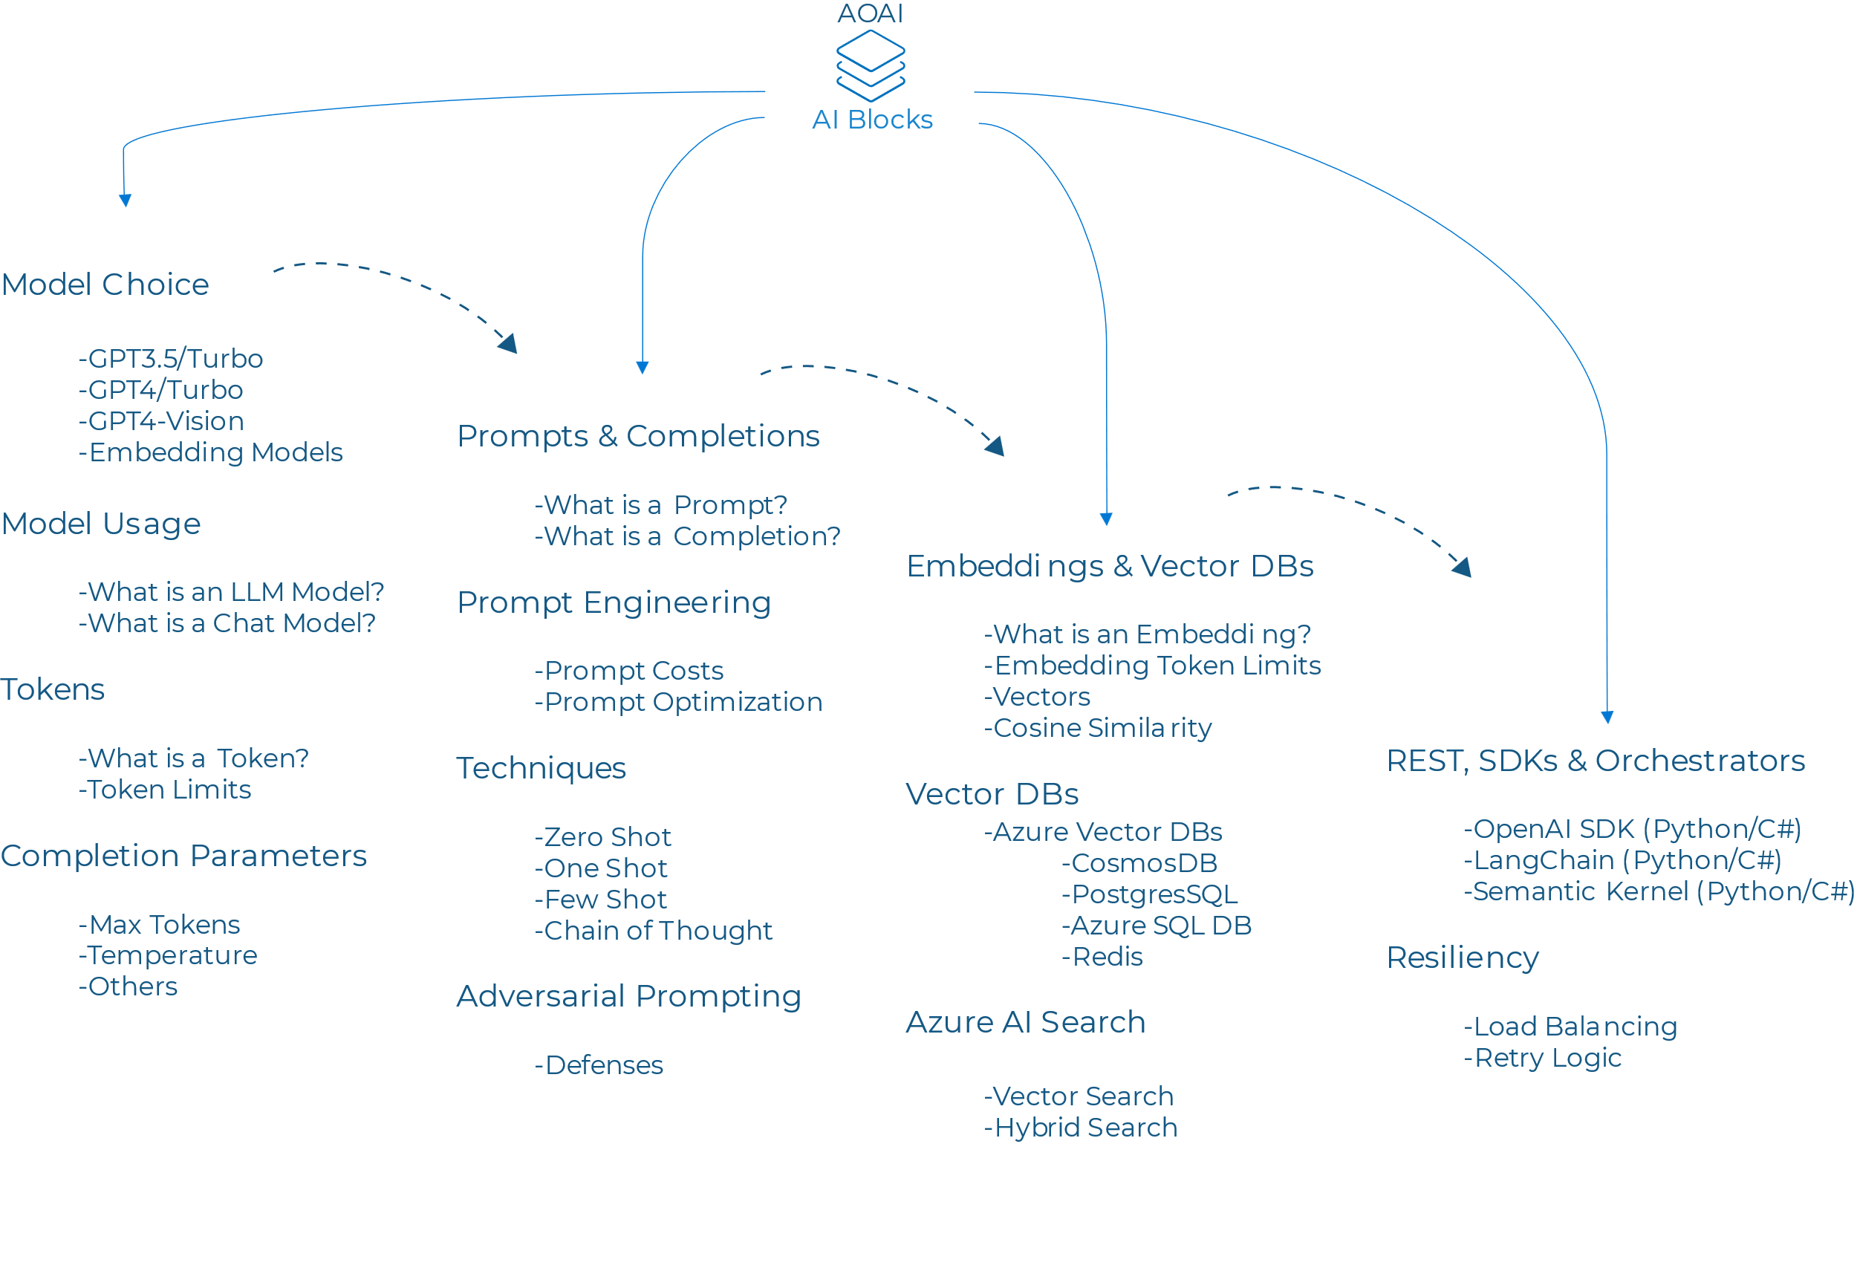

Slide 12
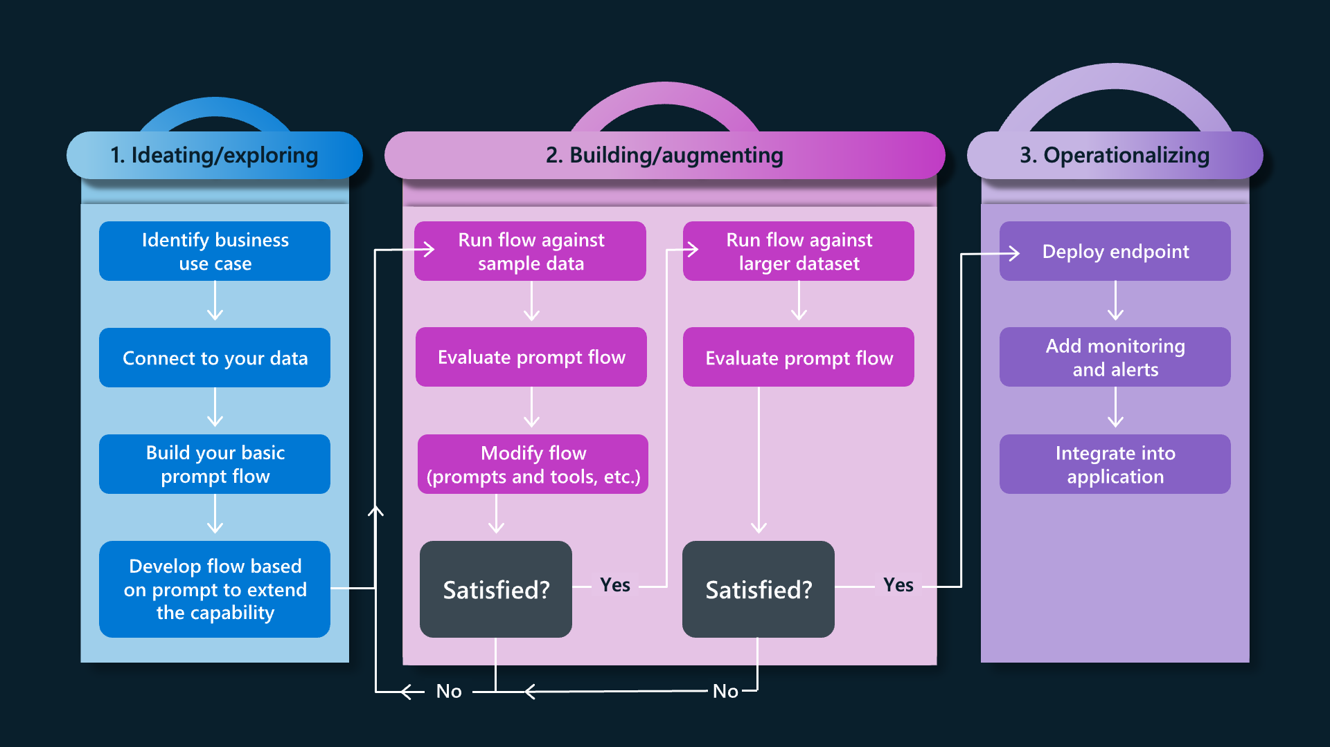
What are the steps I take when I’m doing this?
Notes:
https://azure.microsoft.com/en-us/blog/the-new-ai-imperative-unlock-repeatable-value-for-your-organization-with-llmops/
Startup or initialization - During this phase, you select your business use case and often work to get a proof of concept up and running quickly. Selecting the user experience you want, the data you want to pull into the experience (e.g. through retrieval augmented generation), and answering the business questions about the impact you expect are part of this phase. In Azure AI, you might create an Azure AI Search index on data and use the user interface to add your data to a model like GPT 4 to create an endpoint to get started.
Evaluation and Refinement - Once the Proof of Concept exists, the work turns to refinement—experimenting with different meta prompts, different ways to index the data, and different models are part of this phase. Using prompt flow you’d be able to create these flows and experiments, run the flow against sample data, evaluate the prompt’s performance, and iterate on the flow if necessary. Assess the flow’s performance by running it against a larger dataset, evaluate the prompt’s effectiveness, and refine it as needed. Proceed to the next stage if the results meet the desired criteria.
Production—Once the system behaves as you expect in evaluation, you deploy it using your standard DevOps practices, and you’d use Azure AI to monitor its performance in a production environment, and gather usage data and feedback. This information is part of the set you then use to improve the flow and contribute to earlier stages for further iterations.
Operationalizing loop
The third loop captures the transition of LLMs from development to production. This loop primarily involves deployment, monitoring, incorporating content safety systems, and integrating with CI/CD (continuous integration and continuous deployment) processes.
-Deployment allows for a seamless transfer of LLMs and prompt flows to endpoints for inference without the need for a complex infrastructure setup.
-Monitoring helps teams track and optimize their LLM application’s safety and quality in production.
-Content safety systems help detect and mitigate misuse and unwanted content, both on the ingress and egress of the application.
-Developers can also use Azure AI Content Safety to detect and mitigate harmful content or use the built-in content safety filters provided with Azure OpenAI Service models.
-Combined, these systems fortify the application against potential risks, improving alignment with risk, governance, and compliance standards.
Ground organizations in responsible AI approaches and best practices, as well as data governance considerations as companies innovate now and towards the future.

Slide 13
AI Tools Options for Developers (1/2)
AI tools from Microsoft, OpenAI, and GitHub
VSCode / VS2022/ GH Workspaces: Developer IDE with AI Extensions & Capabilities
GitHub Copilot: works in the code editor to improve coding efficiency and accuracy
Azure AI services: enables developers to build AI-powered apps without ML expertise
Azure AI Studio: enables developers to build, train, and deploy machine learning models
AI Builder: enables users to add AI capabilities to their apps without tech expertise
Visual Studio IntelliCode: provides AI-powered code completions and refactoring assistance
LLMs (GPT): Large Language Models, trained on a wide range of topics, from different partners apart from OpenAI (Meta Llama, HuggingFace, Microsoft, Google Gemini,…)

Slide 14
AI Tools Options for Developers (2/2)
AI tools from Microsoft, OpenAI, and GitHub
Copilot Studio: PowerApps alike low-code/no-code environment to develop custom Copilots
Azure AI Search: index backend for RAG (Retrieval Augmented Generation) using your own data
Azure ML: Machine Learning integration for training your own data models
Prompt Flow: create flows that link LLMs, prompts, Python code and other tools together
LangChain: open-source framework to create chains (prompts) using connectors
Semantic Kernel: provides the framework needed to create fully automated AI agents
And many mane more…

Slide 15

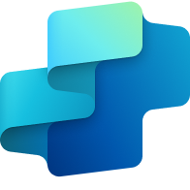
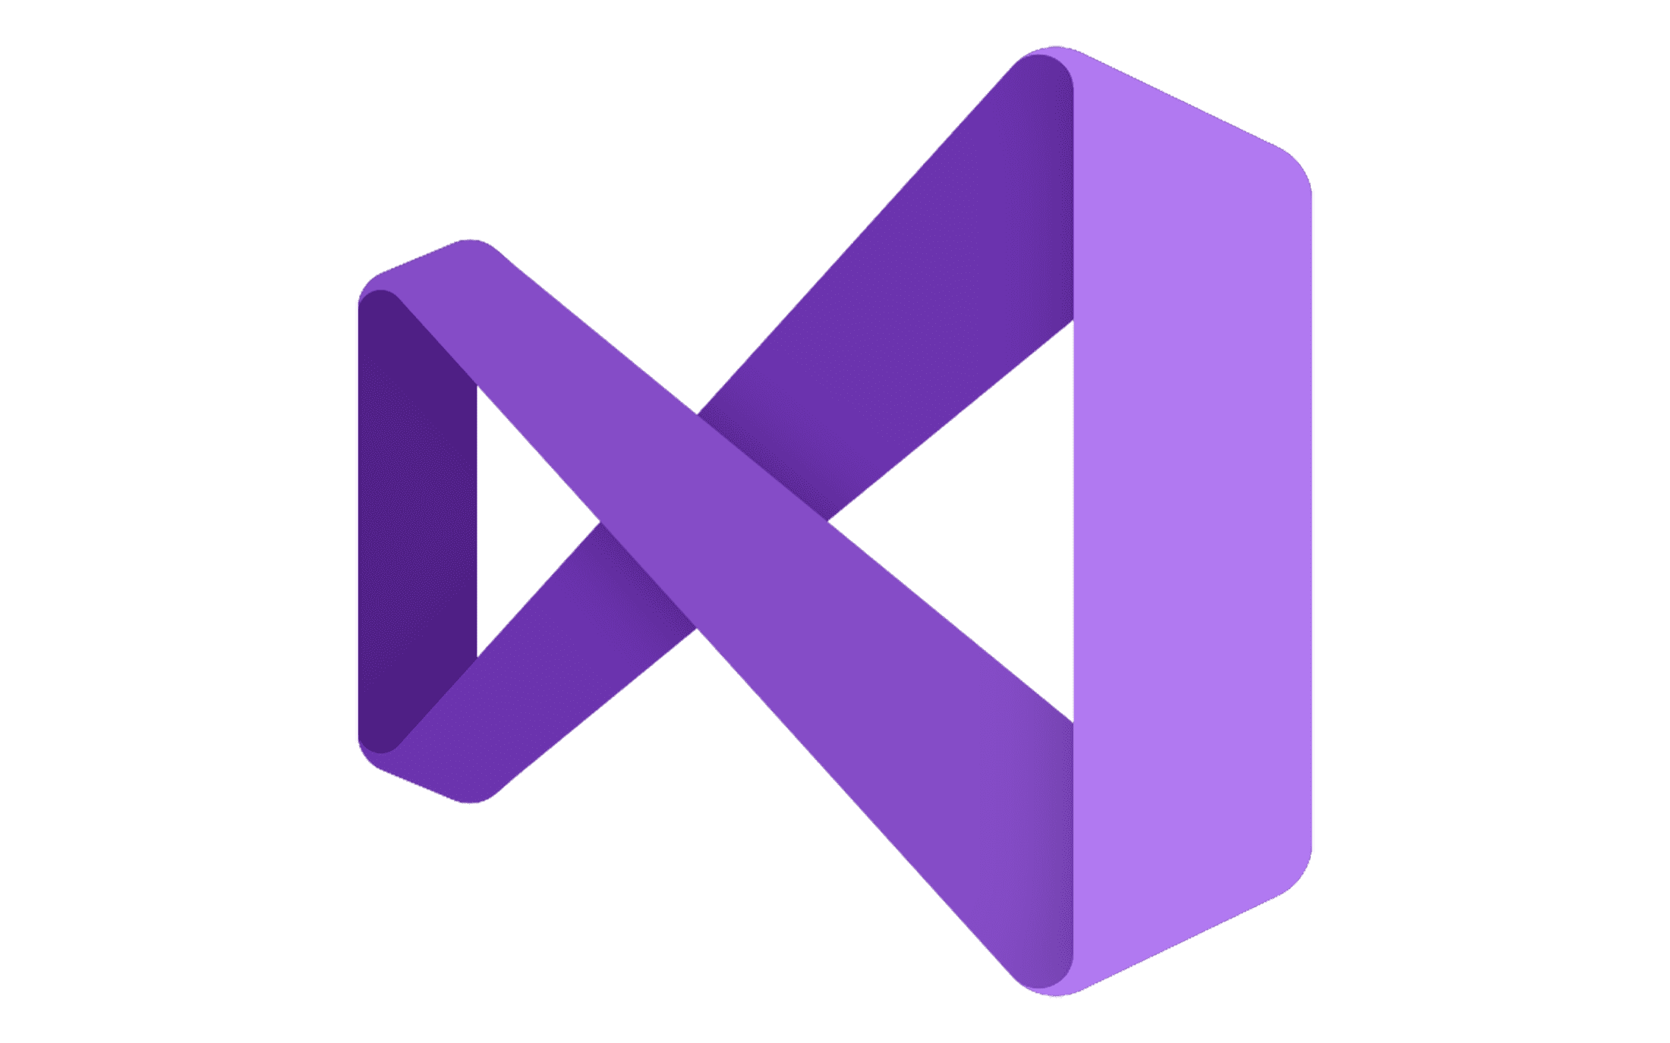

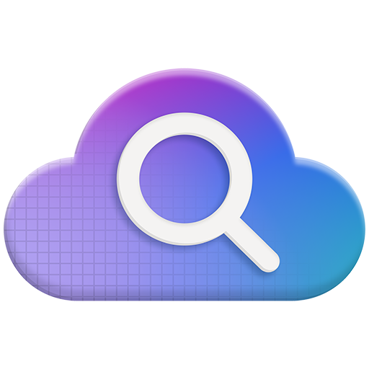
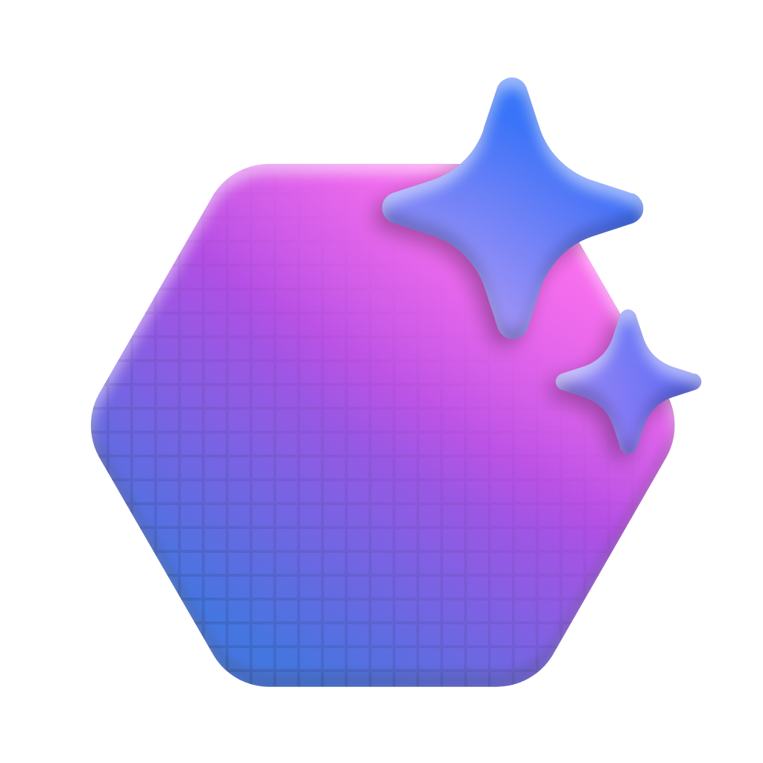


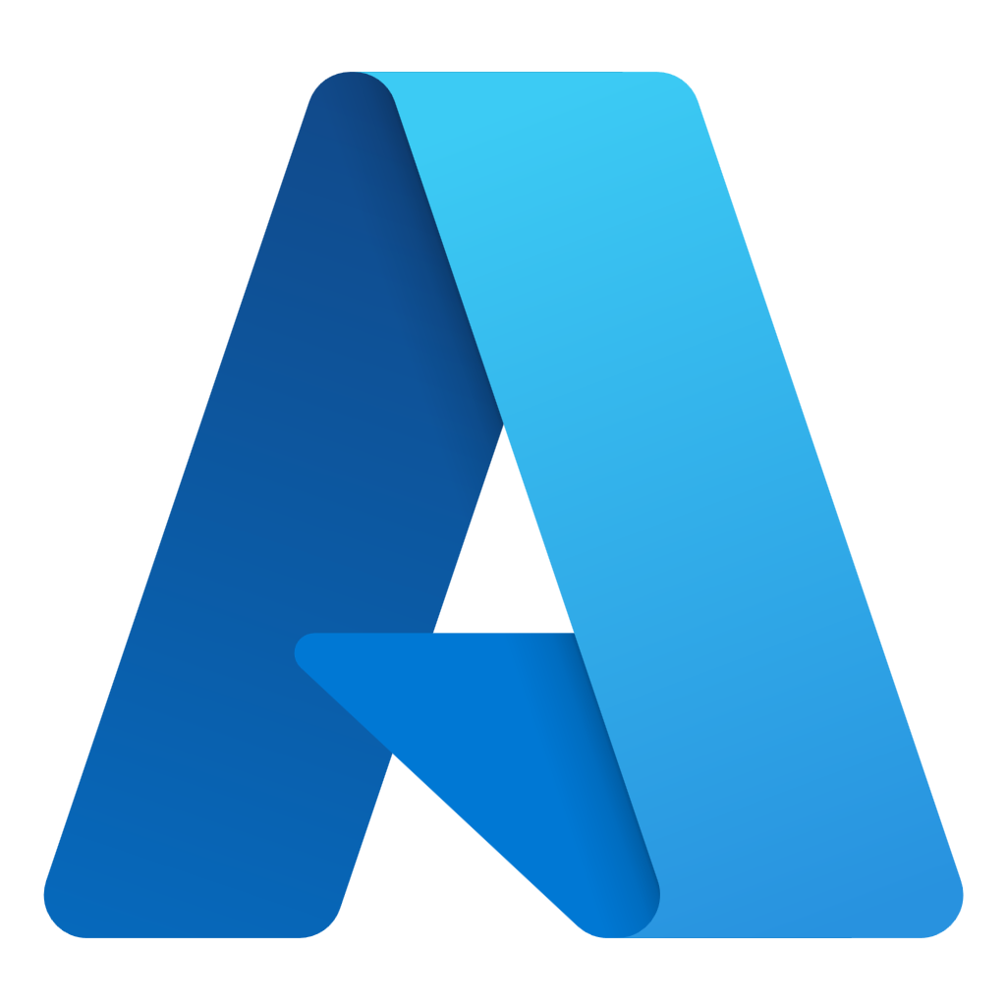
Azure AI Foundry
Announcing
Model Catalog
Copilot Studio
Foundational models
Open-source models
Task models
Industry models
Visual Studio
Azure OpenAI Service
Azure AI Search
Azure AI Agent Service
Azure AI Content Safety
GitHub
Evaluations
Customization
Governance
Monitoring
Azure AI Foundry SDK
Observability
#DataSatMadrid

Slide 16
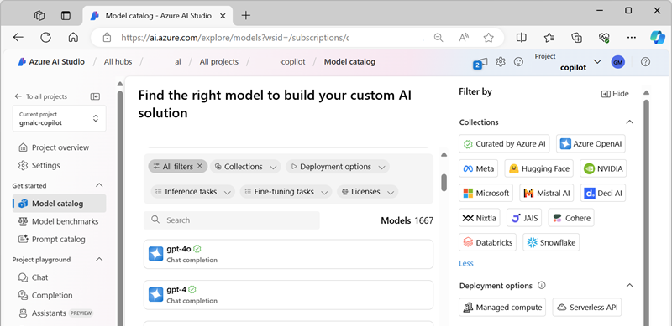
What is the Azure AI Studio?
Pro-code development with full catalog of models and fine-tuning capabilities.
PaaS services with full control over cloud infrastructure.
Prompt and model orchestration.
Evaluations engine to test performance, reliability, scalability, and responsible AI safety.
Deploy as an endpoint in Azure for use in custom apps and services.
Notes:
Tool for developers, data scientists, azure admins,… which brings different solutions together in a single management dashboard…

Slide 17
Add generative AI to your apps to gain true intelligence
Current apps
Intelligent apps
Constrained interactions
Natural language interaction
Paradigm shift
Data-driven, personalized experiences that improve over time
Hard-coded and fixed data sets
Change is costly and complex
Quickly deliver new features
Notes:
Generative AI is what makes apps truly intelligent.
This is a paradigm shift from the present.
AI is moving from its auto-pilot phase, which was all about narrow, purpose-built tools that use machine learning models to make predictions, recommendations, and automate…
to its copilot phase, where there’s tremendous opportunity to revolutionize how just about everything gets done.
With intelligent apps, you can enable natural language interaction, constantly improving user experiences, and quickly deliver new features to market.

Slide 18



Copilot options
Use OpenAI models and up-to-date web data to generate answers with transparent sources
Data travels outside tenant boundary but corporate data is protected from AI training
Copilot
Do you want the model to generate answers based on your own data sources?
No
Yes
Powered by the Microsoft Graph
Integrated into M365 applications
Extensible with an ecosystem of plugins/connectors
M365 Copilot
Managed
I want a generative AI enabled chat application
Do you want to build your own app interface or leverage a managed, integrated experience?
Create chatbot experiences
Leverage low code tools
Grounded on a variety of data sources or webpages
Extend with connectors to additional applications
Build my own
Copilot Studio
Do you need full dev control over the app and model behavior, in addition to data and feature integrations?
No
Developer friendly, enterprise-secure environment to access Azure OpenAI models
Build an internal or external facing chat apps
Use any data source or type
Tailor and optimize chat responses based on your current and latest data
Yes
Azure AI Studio
Notes:
https://learn.microsoft.com/en-us/copilot/fa
M365 = Outlook summarize your emails
Teams = Summarize meeting notes
Ppt, excel
Copilot = Bing Chat

Slide 19
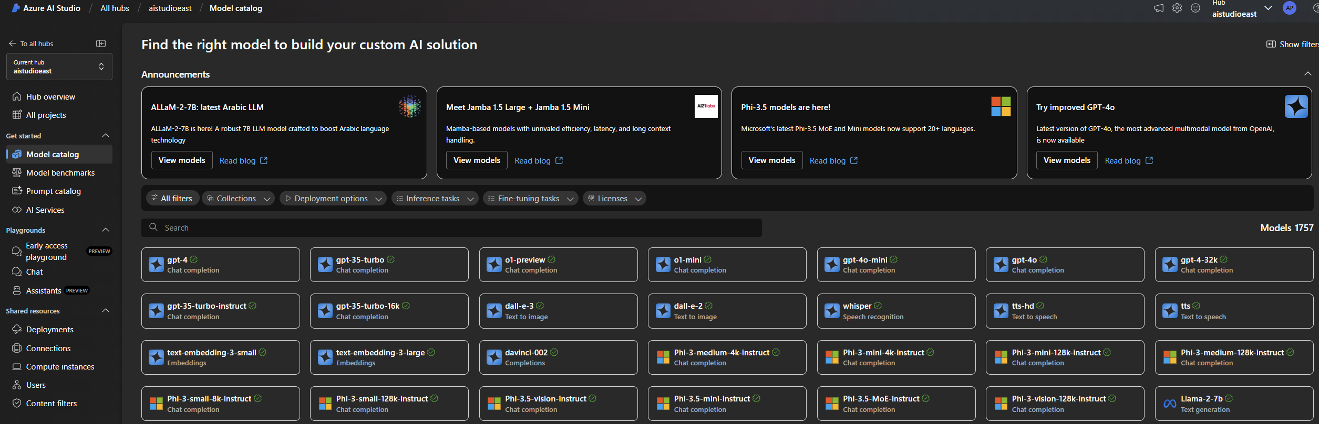
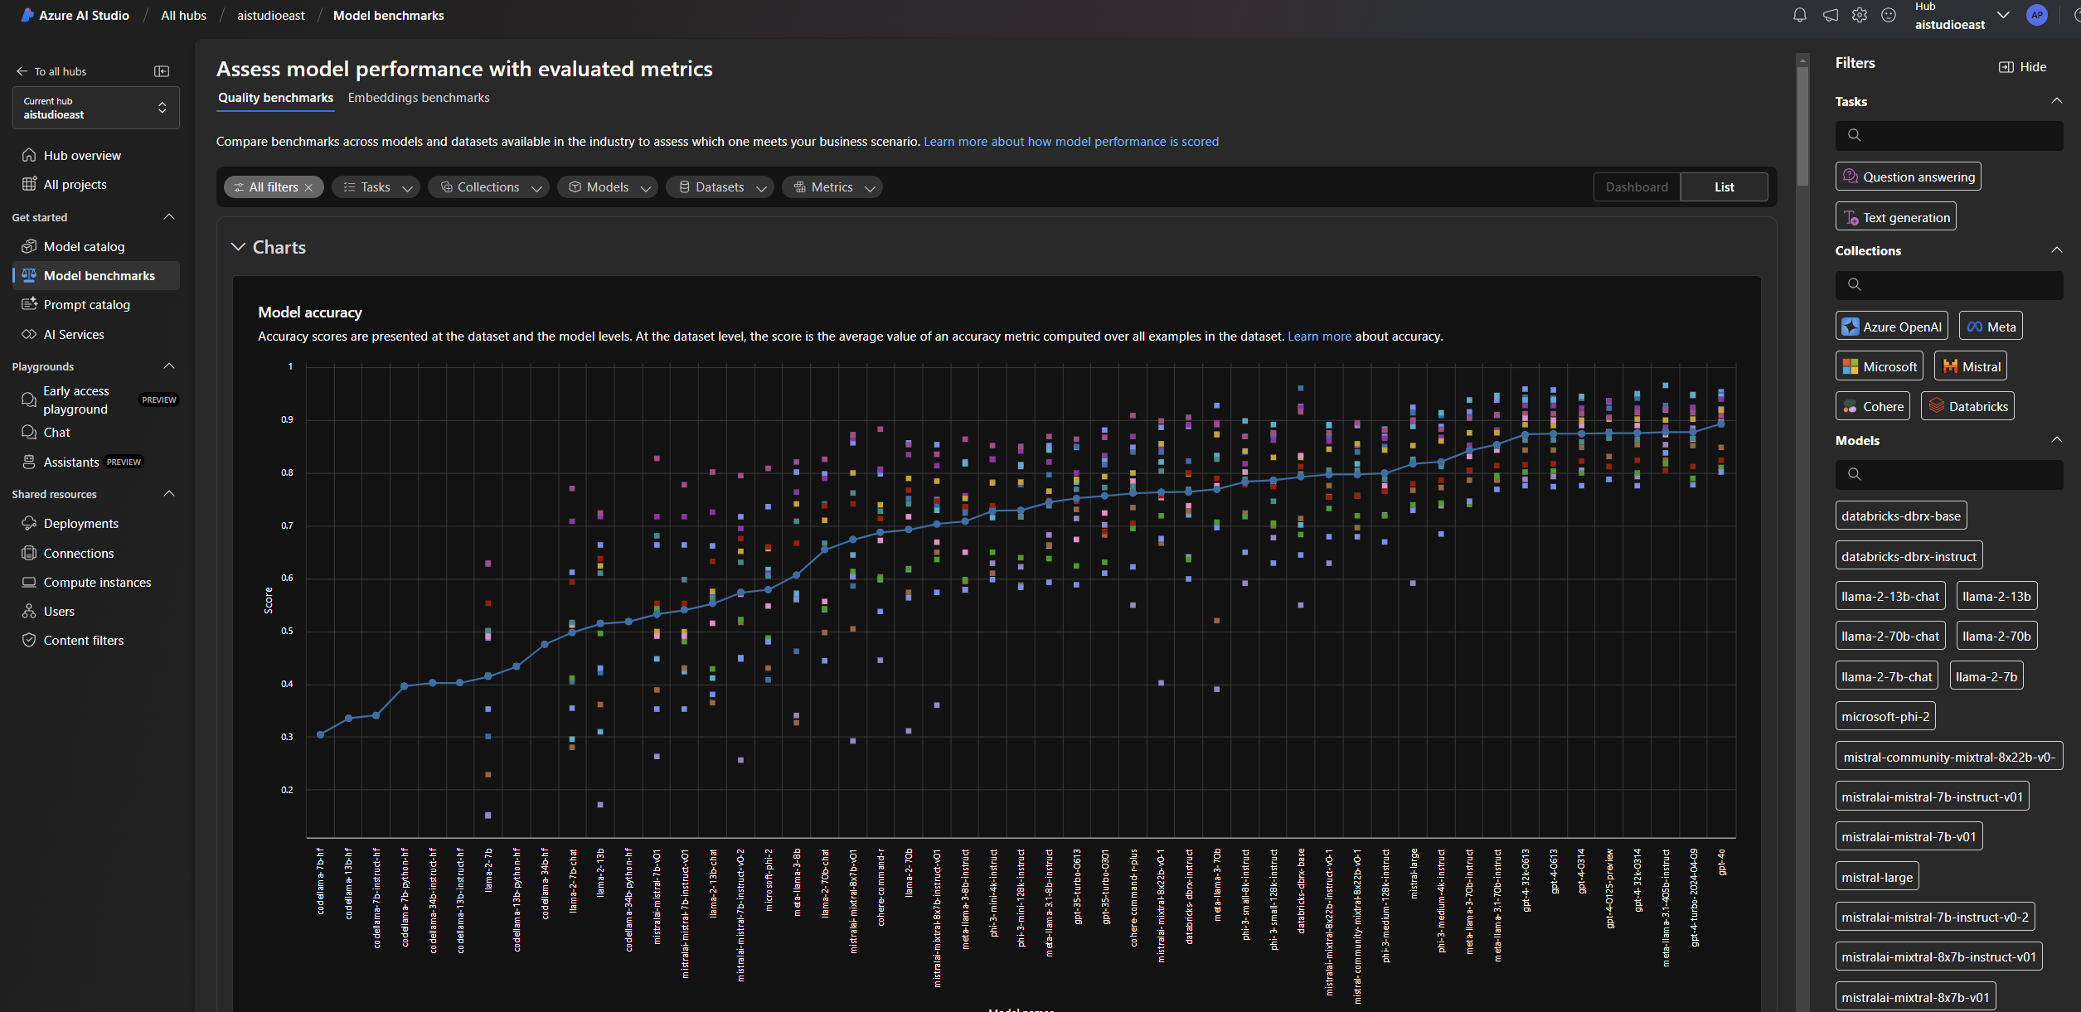
Discover, asses, customize, and deploy models
Azure AI Model Catalog
Hub for discovering foundation models in Azure AI Studio and Azure Machine Learning
1600+ models from OpenAI, Hugging Face, Meta, Mistral, NVIDIA, and more
Ready-to-use with curated fine-tuning pipelines
Easy to compare models by task using open-source datasets
Models available through Models as a Service and Models as Platform
Notes:
https://techcommunity.microsoft.com/t5/ai-machine-learning-blog/model-benchmarks-in-azure-ai-studio/ba-p/3982282

Slide 20

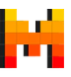
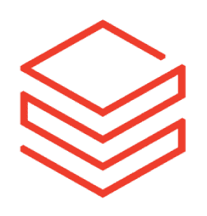







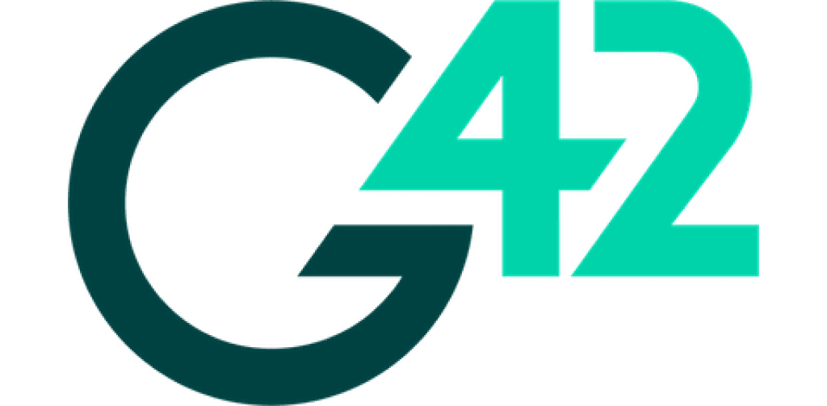

Azure AI offers the best model selection
LLMs and SLMs
Modalities, tasks and tools
Regional and domain specific
Open and propriety
Flagship LLMs
GPT-4
Mistral Large
Llama3 70b
Command R+
Small Language Models
Phi3
Mistral OSS models
Llama3 8b
Multi-modal
GPT-4o, Phi3-vision
Image generation
Dalle3, Stability AI
Embedding models
Ada, Cohere
Function calling & JSON support
Core42 JAIS Arabic language LLM
Mistral Large is focused on European languages
Nixtla TimeGEN-1 - Timeseries forecasting
Premium models first on Azure: OpenAI, Mistral Large, Cohere Command R+
100s of Open models from HuggingFace
Open models from Meta, Databricks and Snowflake, Nvidia
Microsoft Phi
Azure OpenAI
Mistral AI
Meta AI
Databricks
Cohere
Hugging Face
NVIDIA
Deci AI
Nixtla
G42
Snowflake
#DataSatMadrid

Slide 21

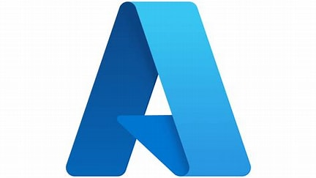




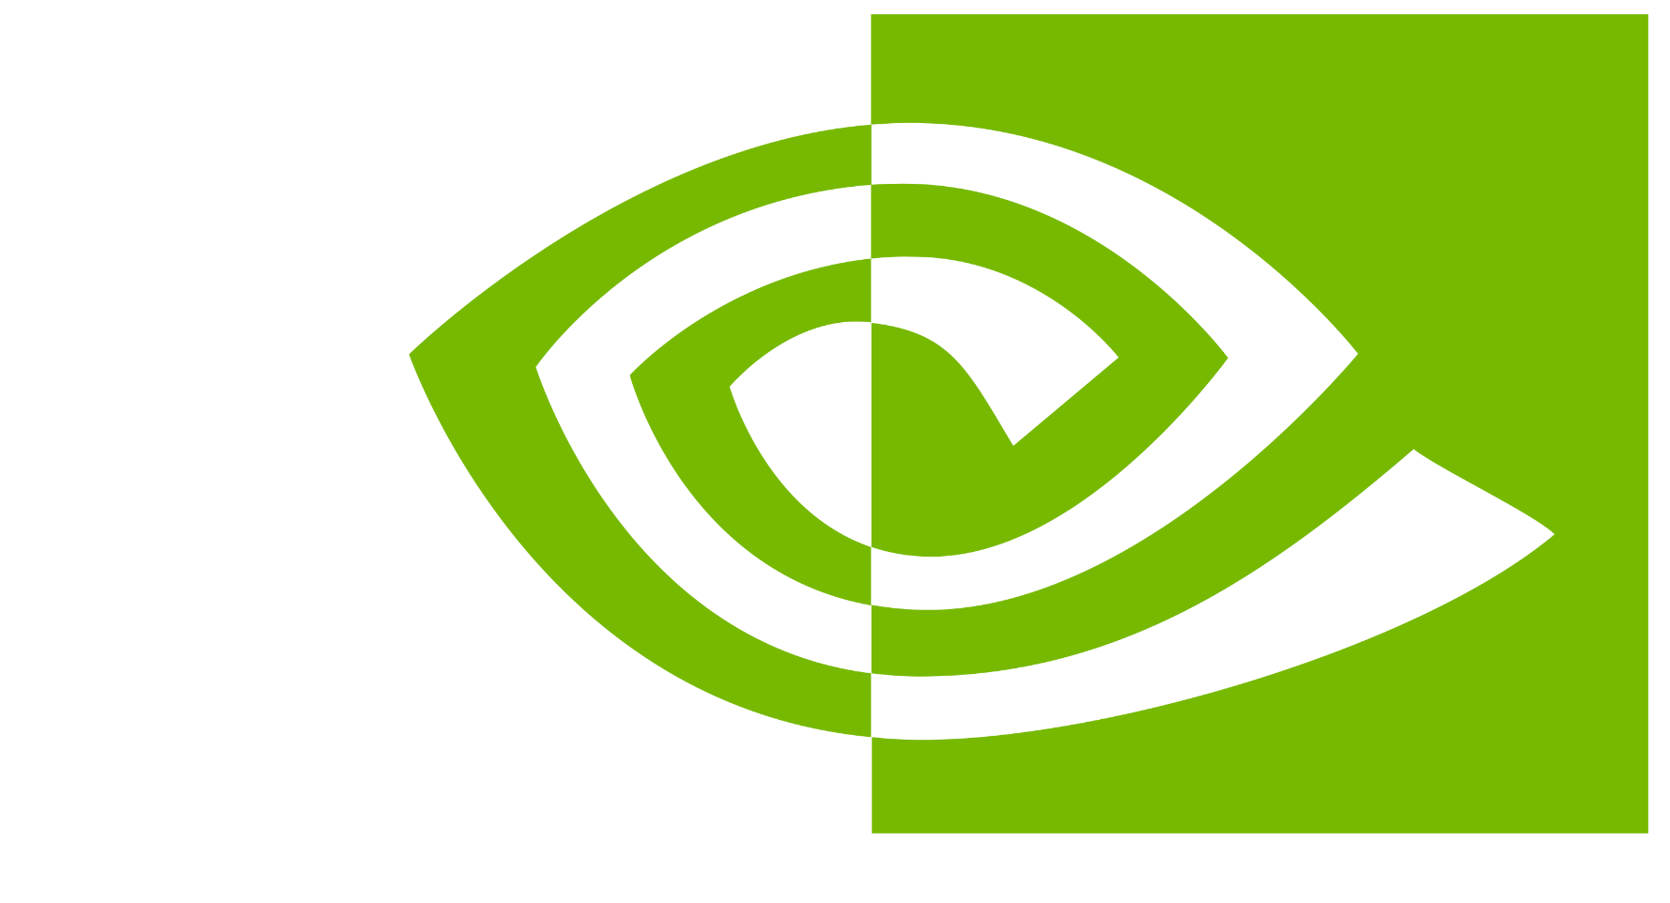

Azure AI Model Catalog
Offering a wide collection of foundation and open models
Azure OpenAI Service
Phi models
Meta
Mistral AI
Cohere
GPT-4o
Phi-3-mini
Llama-2-70b/70b-chat
Mistral Large
Cohere R+
GPT-4-Turbo with Vision, GPT-4, GPT-3.5
Phi-3-small
Llama-2-13b/13b-chat
Mistral 7B
Cohere R
Embeddings
Phi-3-medium
Llama-2-7b/7b-chat
Mixtral 8x7B – Mixture of Experts
Embed v3-Multilingual
DALL·E
Phi-3-vision
Llama-3
Embed v3-English
Whisper, Text to speech
CodeLlama
Hugging Face
Databricks
NVIDIA
Snowflake
Falcon/TII
Databricks/dbrx-base
Nemotron-3-8B-4k
Snowflake/arctic-base
Stable Diffusion/Stability AI
Databricks/dbrx-instruct
Nemotron-3-8B-Chat-SFT/RLHF/ SteerLM
Snowflake/arctic-instruct
Dolly/Databricks
Nemotron-3-8B-QA
CLIP/OpenAI
#DataSatMadrid
Notes:
With Azure AI, we bring a comprehensive selection of frontier and open models, enabling customers to choose the models that make most sense for their solutions. We have expanded our model collection by curating our own AI models and announcing new partnerships with industry-leading generative AI model providers by 7X in the past 6 months. The Azure AI model catalog now offers nearly 1,600 foundation models (LLMs and SLMs) from Databricks, Deci AI, Hugging Face, Meta, Microsoft Research, Mistral AI, NVIDIA, OpenAI, Stability AI – and now Cohere – enabling Azure customers to choose the best model for their use case.

Slide 22


AI Studio: Model catalog
AOAI & MaaS
Models as a Platform (MaaP)
Ready to use model APIs
Pay-per-token or pay-for-provisioned-capacity billing
30+ flagship models
Infrastructure to scale up & out; built in security & reliability
Deployed to managed Azure VMs
One click deployment that boots up an optimized container and initializes the weights.
Pay-per-GPU billing
100s of open models
OSS Models
You are responsible for deploying and maintaining your finished models

Slide 23
A year of rapid growth and innovation
2023 Ignite
2024 Jan-Oct
2024 Ignite
GA of Model Catalog and Launched Models as a Service (MaaS) at Ignite in partnership with Meta Llama
Launched 50+ MaaS models Cohere, Mistral, AI21, G42, Phi, Meta, Nixtla
250+ OSS models on Managed
compute
Launched models on Github
Over 1800+ models in the catalog and continuing the momentum with new models
Providing flexible deployment options
Seamless experimentation with Azure AI Model Inference API
Azure AI Model Catalog continues to evolve, providing a diverse range of AI models and unparalleled flexibility for enterprise use cases
#DataSatMadrid

Slide 24
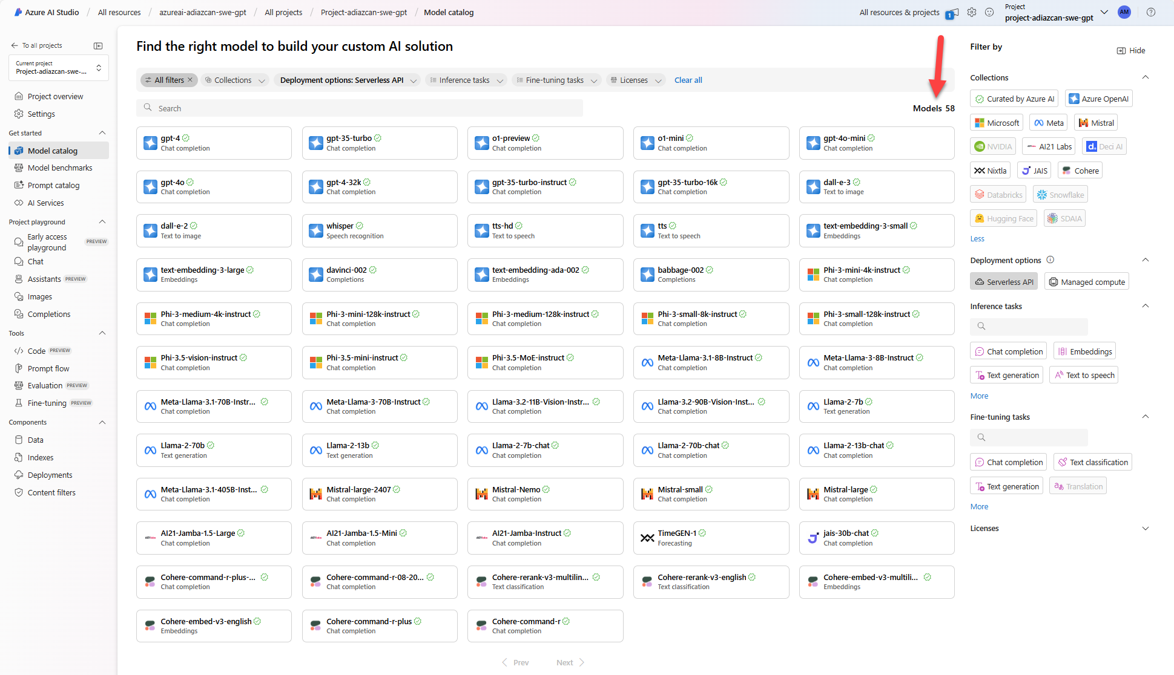
Demo Show Model Catalog

Slide 25
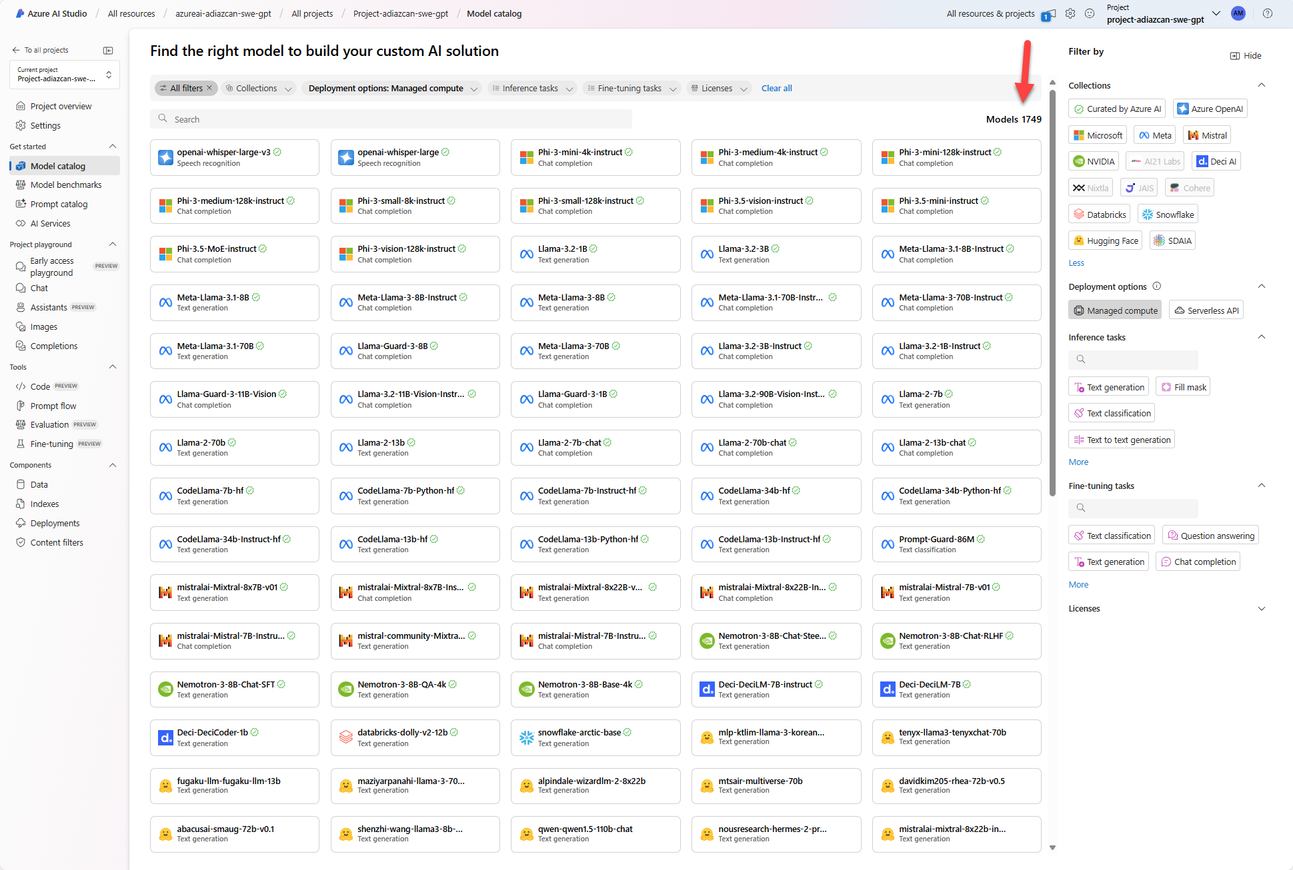

Slide 26
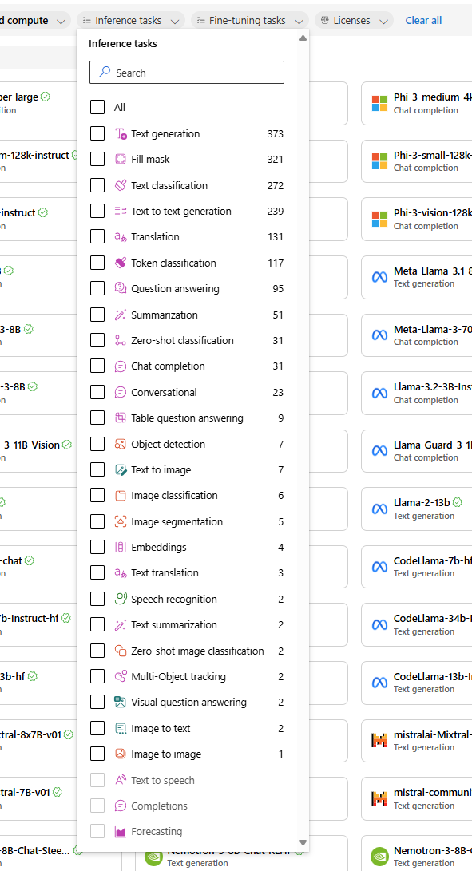
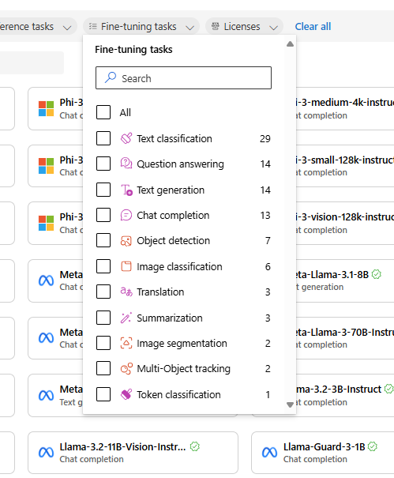
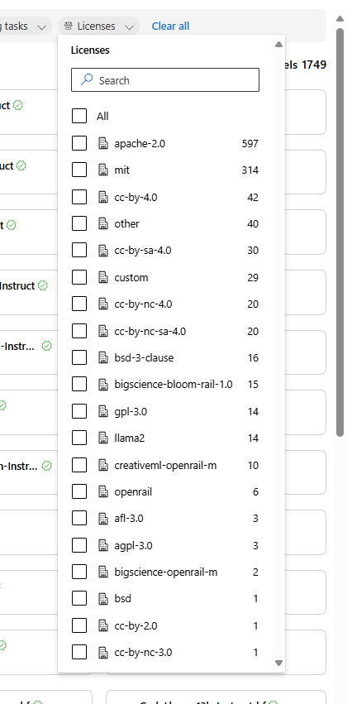

Slide 27
Making the right choice
Ask the right questions
Establish your criteria for measuring success/failure
Shortlist models for evaluation
#DataSatMadrid

Slide 28
Making model selection simple
Model Inference API
Azure AI Model Catalog
Benchmarking
Simple fine-tuning
Evaluation SDK

Slide 29



Model Catalog meets key enterprise requirements
Data privacy
Security and compliance
Responsible AI and content safety
#DataSatMadrid

Slide 30
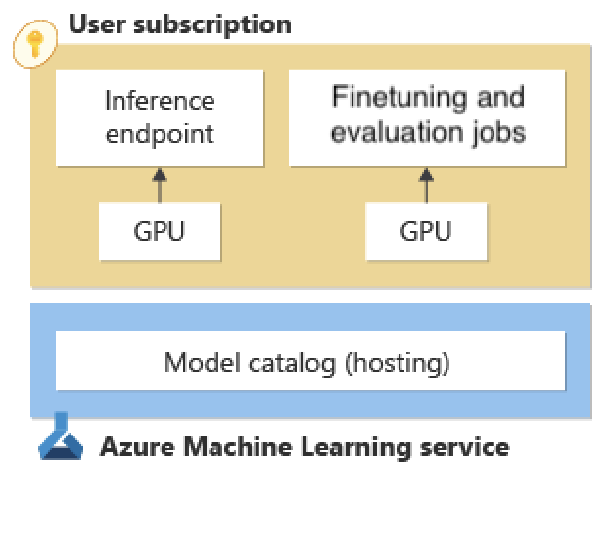
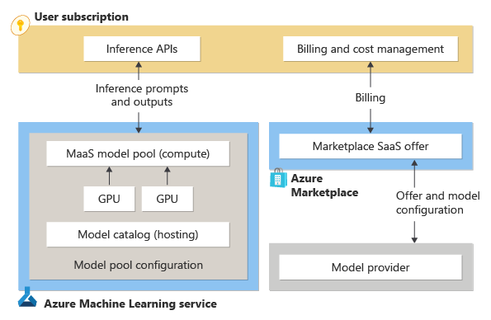
Data privacy
Managed compute
Serverless APIs
Your prompts and completions are not shared with model providers
Your prompts and completions not used for training models
#DataSatMadrid

Slide 31
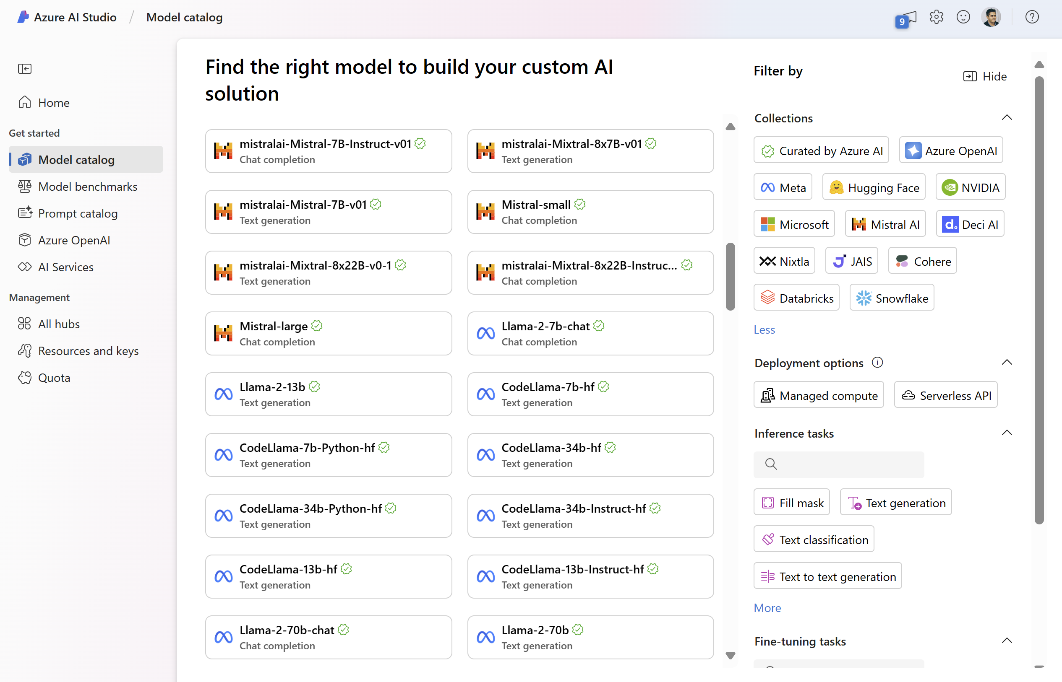
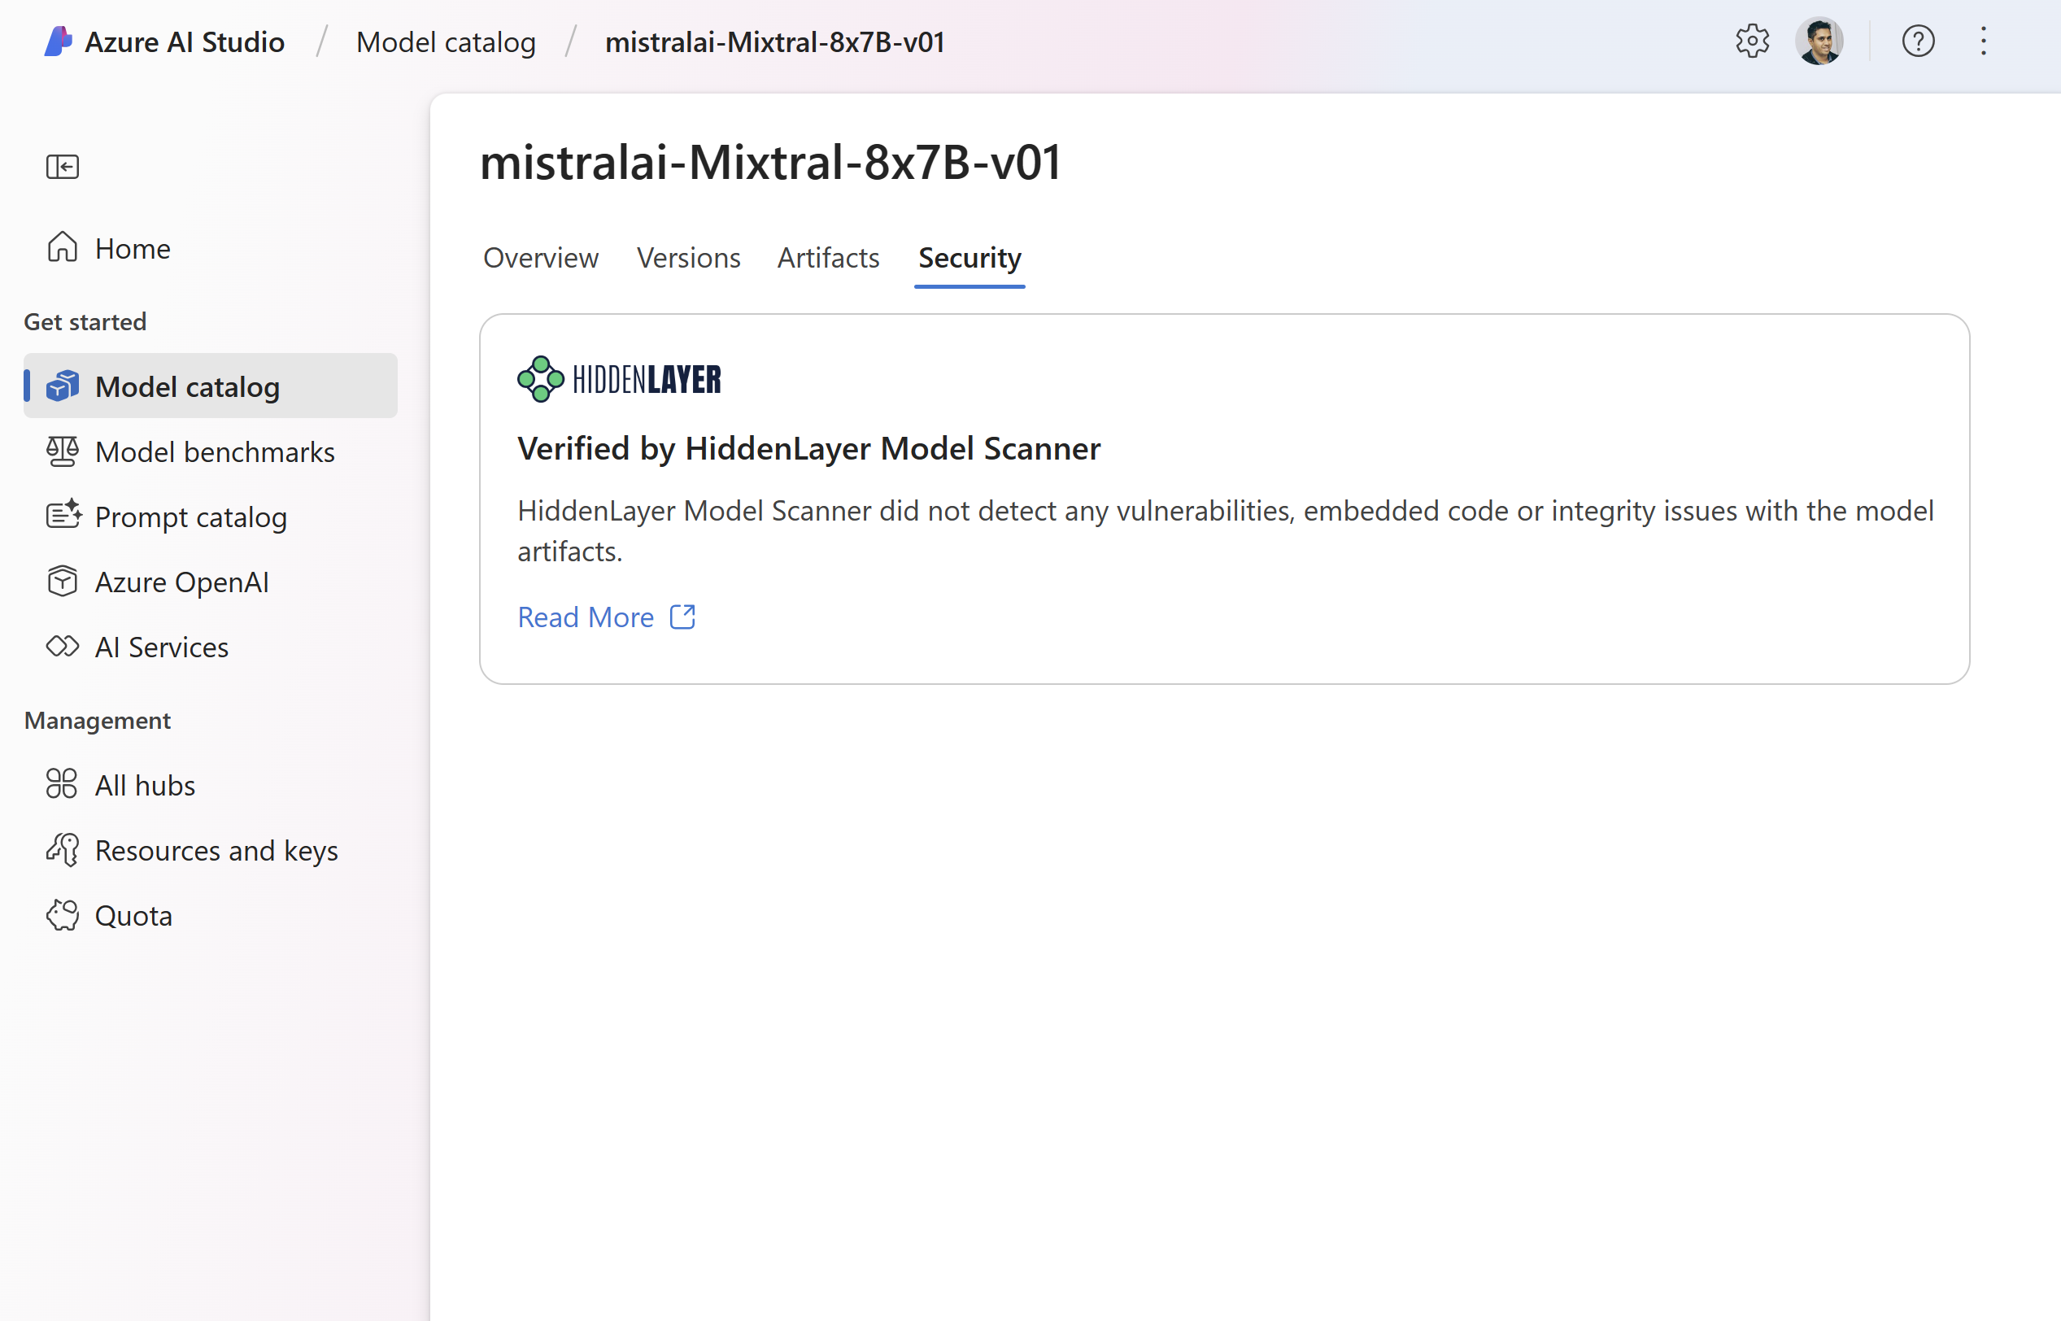
Vulnerability scanning with Hidden Layer model scanner
Finds embedded malware and backdoors
Scans for common vulnerabilities and exposures
Detects tampering and corruption across model layers

Slide 32


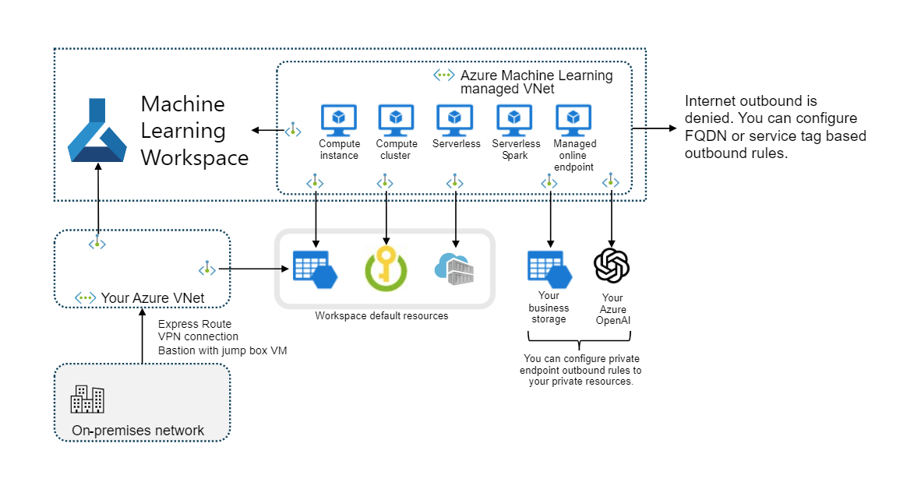
Security and Compliance
Model Catalog infrastructure
Built-in service endpoint policy to AzureML managed storage accounts and Microsoft Container Registry
Allow outbound FQDN rules for Hugging Face Hub and Docker Hub
Private networking – your data is not exposed to the internet
Route inbound and outbound traffic through Virtual Networks
FQDN rules to approve outbound to non-Azure resources
#DataSatMadrid

Slide 33
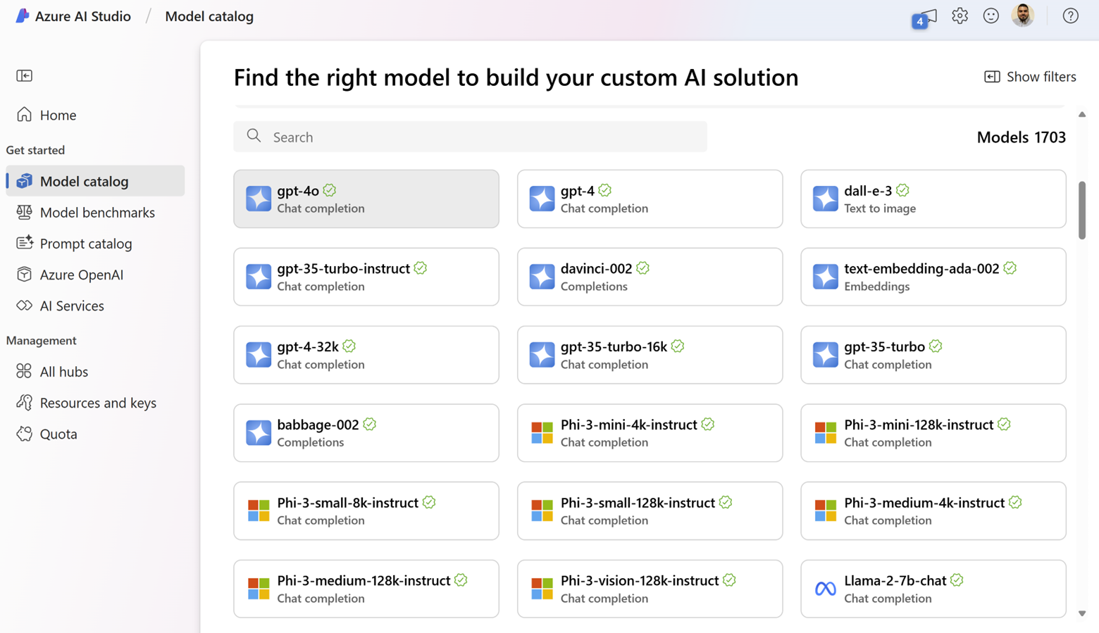
Azure AI Model Catalog
DEMO
#DataSatMadrid
Notes:
With Azure AI, we bring a comprehensive selection of frontier and open models, enabling customers to choose the models that make most sense for their solutions. We have expanded our model collection by curating our own AI models and announcing new partnerships with industry-leading generative AI model providers by 7X in the past 6 months. The Azure AI model catalog now offers nearly 1,600 foundation models (LLMs and SLMs) from Databricks, Deci AI, Hugging Face, Meta, Microsoft Research, Mistral AI, NVIDIA, OpenAI, Stability AI – and now Cohere – enabling Azure customers to choose the best model for their use case.

Slide 34
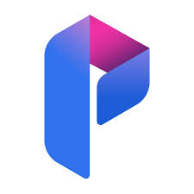
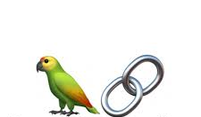
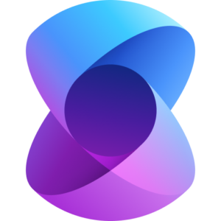

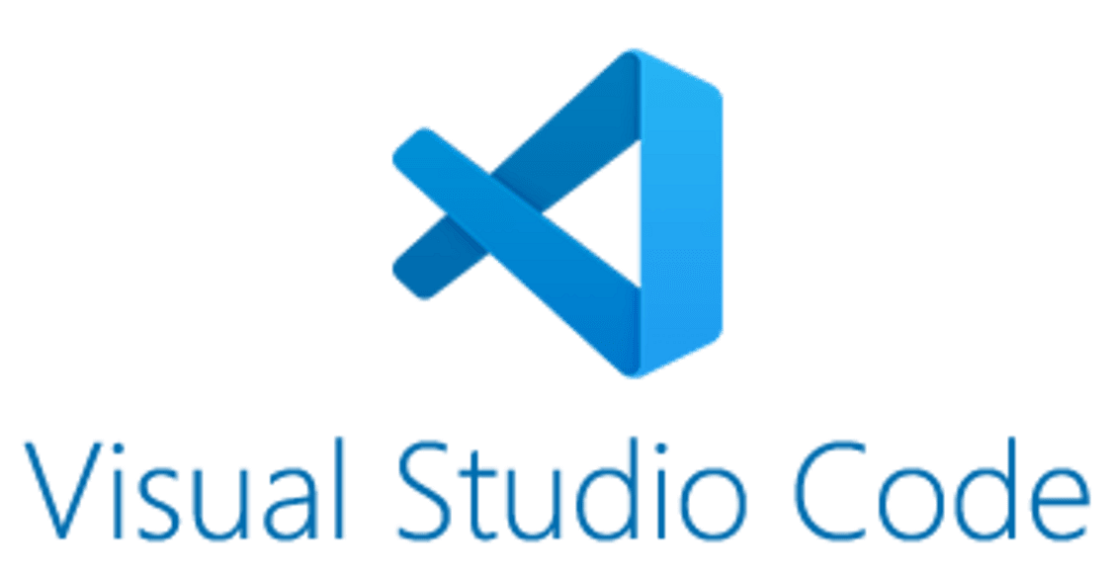
Azure AI model inference API works with favorite SDK
Consistent schema
Unified API schema that works across all models
Advanced capabilities
Custom parameters that are unique to each model
Advanced capabilities like function calling and JSON support
Rich client support
“Model inference SDK” for multiple languages
Integration with LLM App development tools like prompt flow, Lang Chain, Semantic Kernal and more
Azure AI Prompt Flow
+
azure-ai-inference SDK
(coming in early June)
Popular OSS tools like
Lang Chain and Semantic Kernel
Model provider SDKs

Slide 35

Model Customization
External knowledge required
high
Hybrid (fine-tuning + RAG)
RAG
Fine-tuning
low
low
high
Model adaptation required (e.g., behavior/writing style/vocabulary)
#DataSatMadrid

